Slide 1
SPEED CAMERA VIOLATIONS
CS 424 Project - 1
Shiva Praveen Donga
Indu Reddy Pati

Slide 2
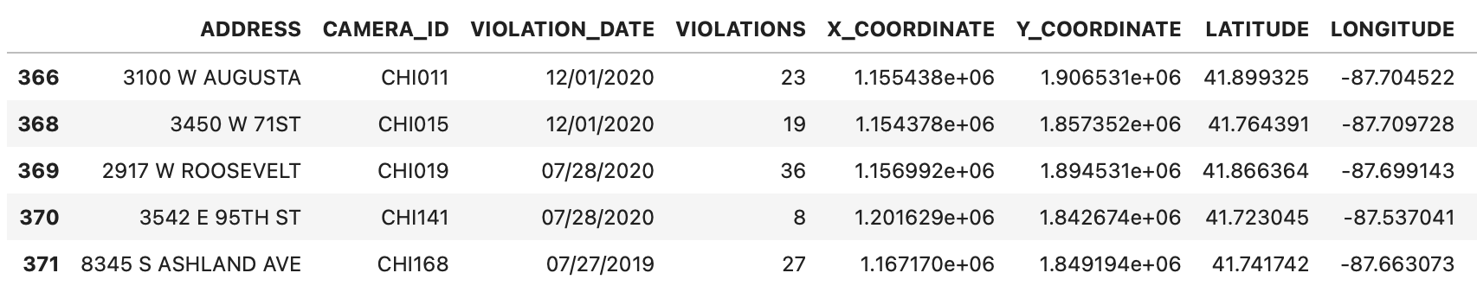
Dataset Overview:
Data between 07/01/2014 to 08/31/2022 from Chicago Police Department
The dataset includes 9 columns
With 309320 rows out of which 11782 null data
After .dropna(), total rows 297538

Slide 3
Data Description:
Dataset has:
Max Violation value 827 and Minimum Violation value 1
158 unique Camera IDs
2976 - CHI083
178 - CHI131
160 unique Addresses
202.716567 - 4909 N CICERO AVE
1.320225 - 18 W SUPERIOR ST

Slide 4
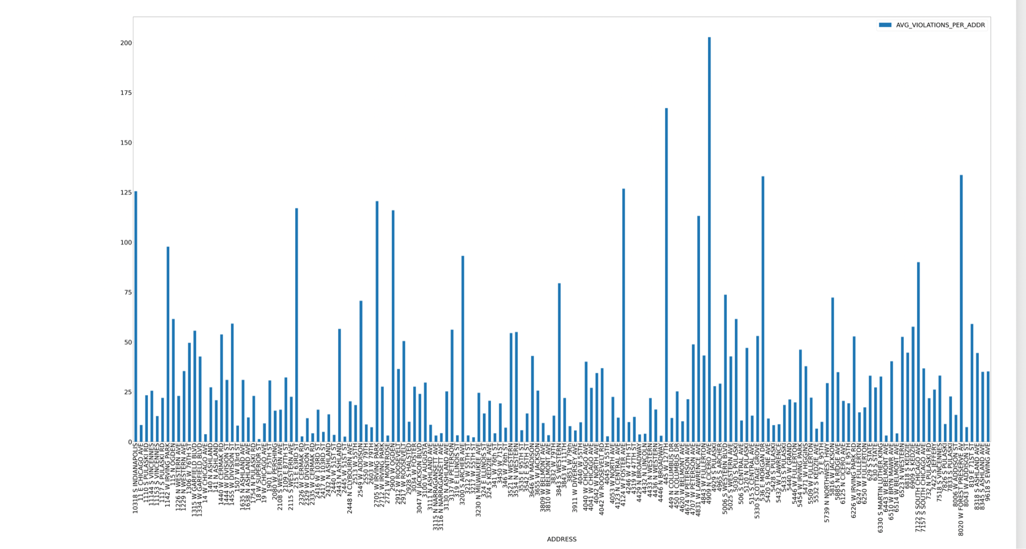
What are Average Speed Violations Per Address over
2014 - 2022?
Notes:
Max violations at address - 4909 N CICERO AVE and 445 west 127th

Slide 5
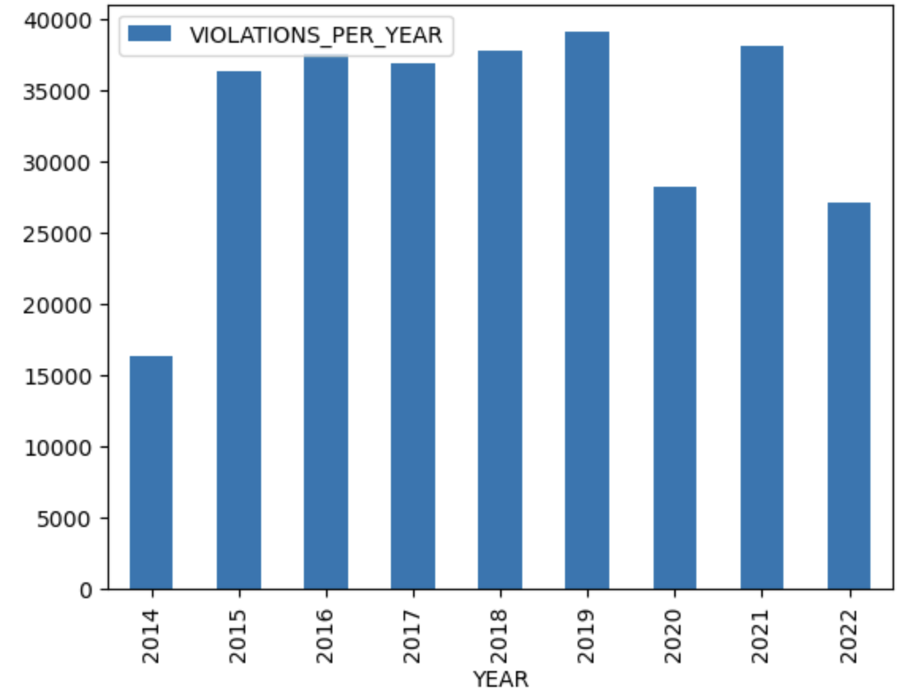
HYPOTHESIS-1
Speed Violations must have decreased over years due to Awareness and Strict Reinforcement of Speed Rules
Conclusion: False
Reasons:
Trend looks same 2015-19 and 2021
Less in 2020 - must be due to Covid Lockdown
2014 and 2022 exceptions - not entire year

Slide 6
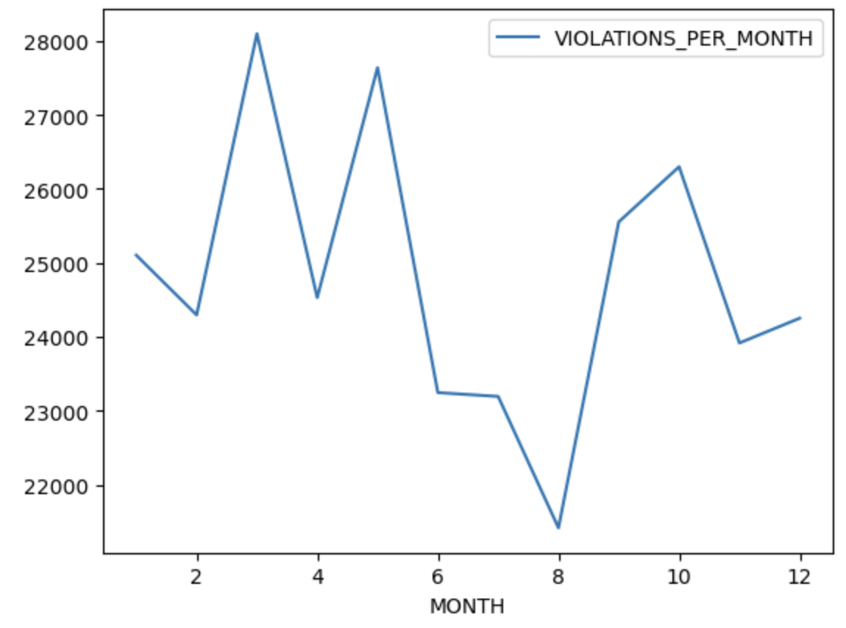
HYPOTHESIS-2
Speed Violation must be less during the winter/summer breaks. As most people will be on vacations and no worries to be not late to work.
Conclusion: True
Reasons:
Less on breaks - On vacation
More during Feb - May
On time for work
Cold weather must be contributing factor for brake lock up

Slide 7
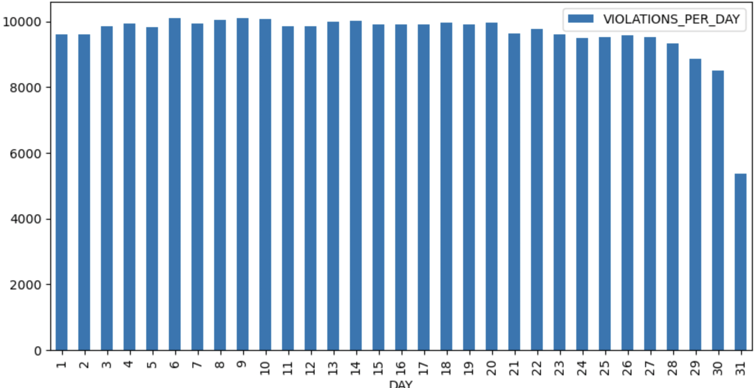
HYPOTHESIS-3
Speed Violation must be similar across days in months
Conclusion: True
Reasons:
no reason for speed violations being less for any days during month.
31st exception - 7 months only

Slide 8
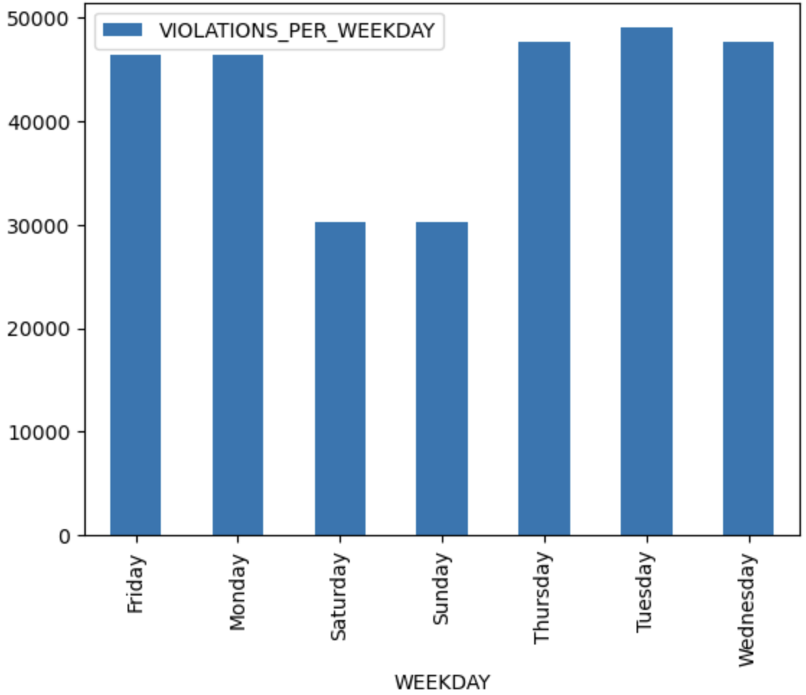
HYPOTHESIS-4
Weekdays have more Speed Violations than Weekends
Conclusion: True
Reasons:
No rush to Work Place
People on weekend trips
Chicago Suburbs for Visiting, Hiking etc.

Slide 9
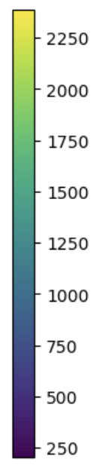
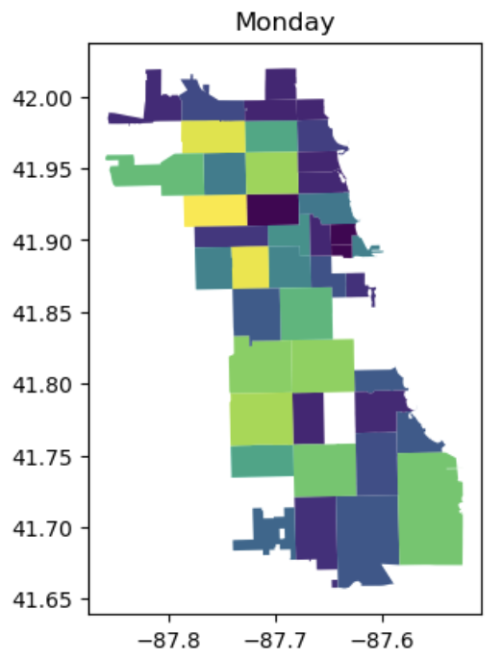
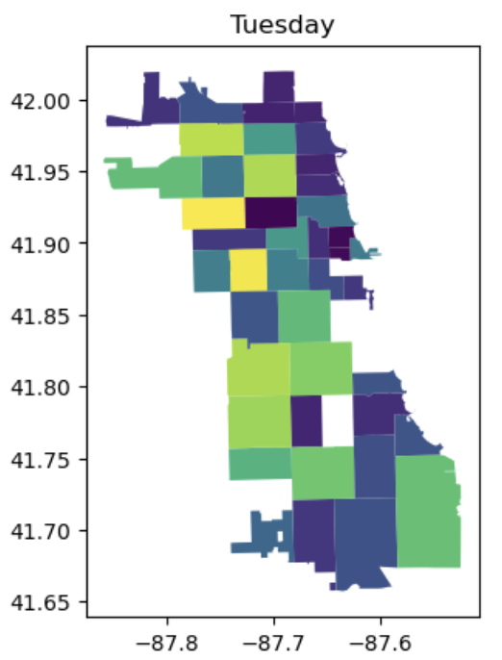
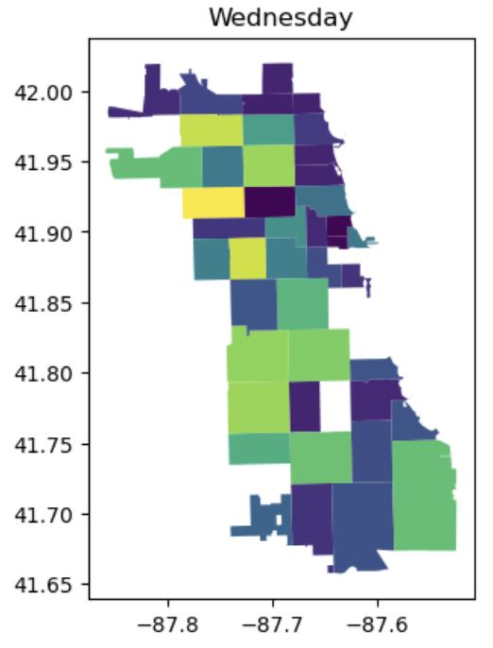

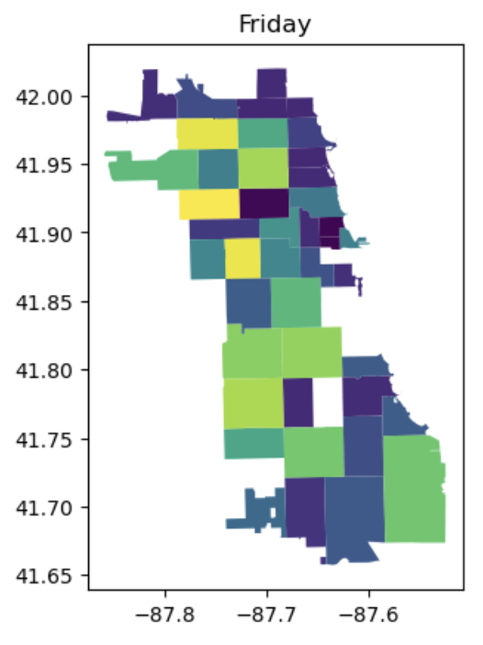
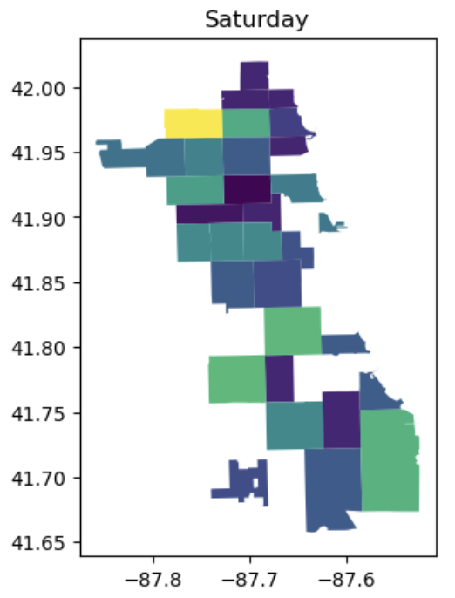
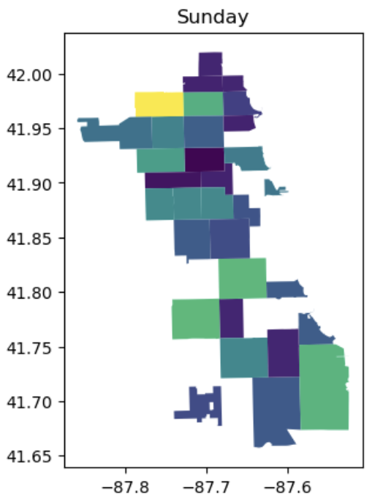
No violations (Blank White Space in Heat Map) in certain Zip codes - Ashburn, Beverly etc.

Slide 10
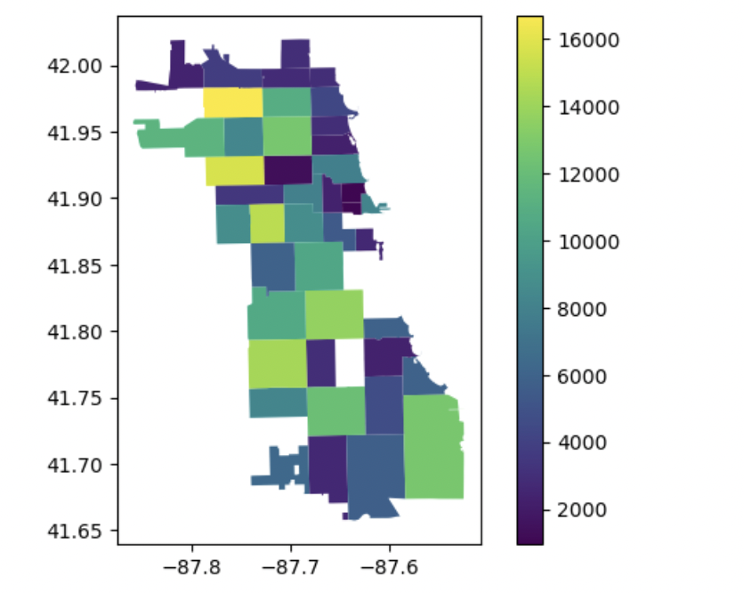
Speed Violations Visualization on Chicago Map
No Violations:
60601 - 07 Downtown Chicago, Loop
Douglas, Oakland, Englewood- School Zone
Most Violations:
North West Neighbourhoods - Jefferson Park, Belmont, Garfield Park
South West Neighbourhoods - Ashburn, Bridgeport

Slide 11
Thank you!

